Slide 1


Does Washington DC Weather Impact It’s Crime?
GWU – DATA ANALYSIS BOOTCAMP
Project One, Group 2
Group Members: Vikas Agrawal, Yonatan Gorin, Desiree Joseph, Beth Wilde
February 15, 2023

Slide 2
Questions we found interesting and what motivated us to answer them

Slide 3
Purpose
Is there a correlation between different weather conditions common in DC and the rate of crime?
To provide information on weather and crime to help determine if there is a need for resources should be expended for specific weather conditions.
Is there any benefit to having additional patrols during specific weather conditions and additional weather gear provided for external patrols?

Slide 4
Questions to answer
Does precipitation affect crime rate?
Does humidity affect crime rate?
Does temperature affect crime rate?

Slide 5
Where and how we found the data to answer our questions The data exploration and cleanup process

Slide 6

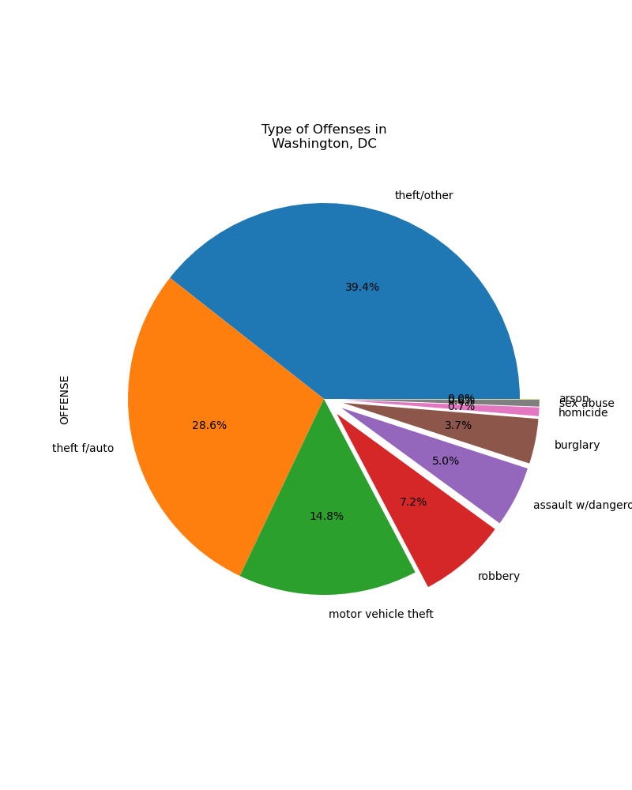



Overall Reported Crime for DC for the past year
A review of official crime reported statistics for the DC was reviewed for the time period of February 1, 2022, and February 6, 2023 and included 27,697 reports.
Data found that two of the most commonly reported offenses dealt with the common element of automobiles
There were 7,908 reports of thefts from vehicles
There were 4,094 reports of motor vehicles thefts
The most common type of offense reported was the theft other category, which does not relate to a single offense, Due to the vague nature of these category, no additional review was performed
There were 10,910 reports for this category

Slide 7
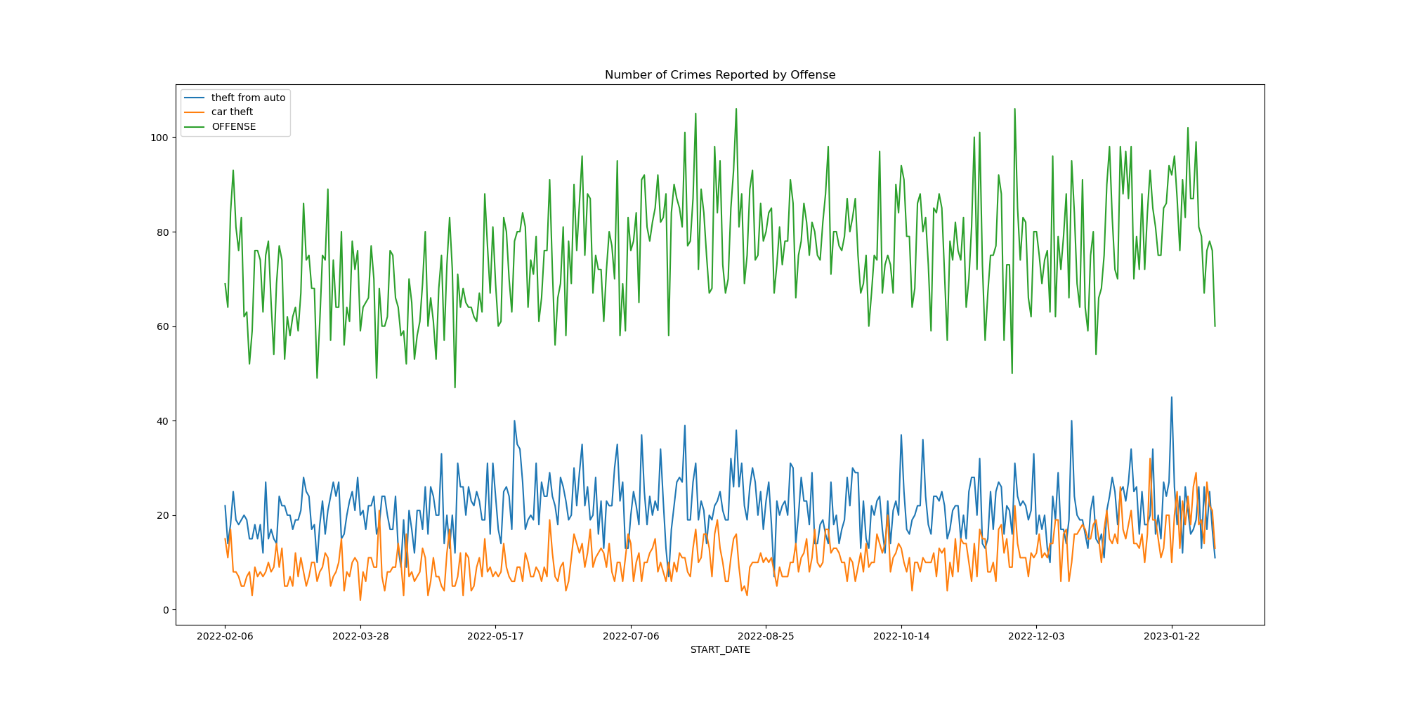
Daily reported crime rates
The mean, median and mode for theft from auto is: 21.54, 21.0 , and 20
The mean, median and mode for car theft is: 11.16, 10.0, and 10
There is an average of 75 overall crimes reported per day; 21 of the are thefts from vehicles and 11 are motor vehicle

Slide 8

Notes:
Jonathan

Slide 9
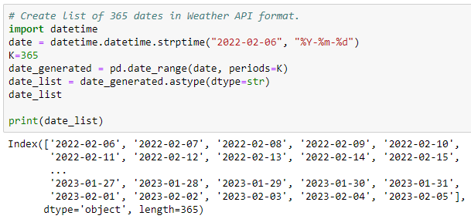
datetime Module
Notes:
Jonathan

Slide 10
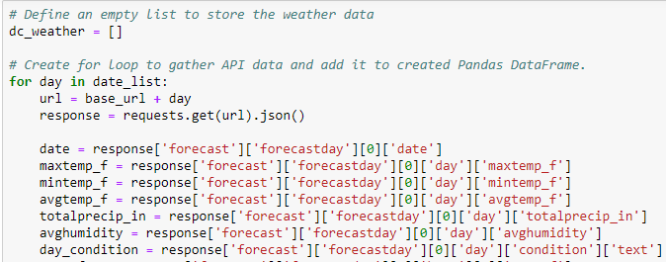
API Request
Notes:
Jonathan

Slide 11
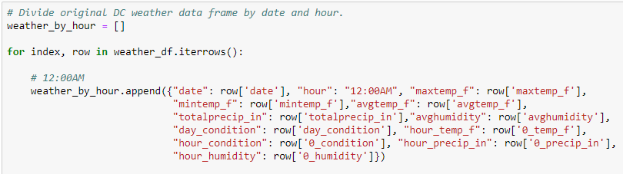
Weather by Hour
Notes:
Jonathan

Slide 12
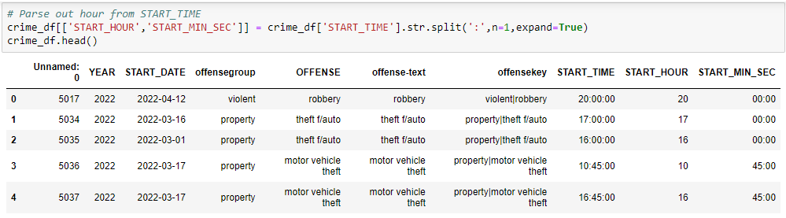
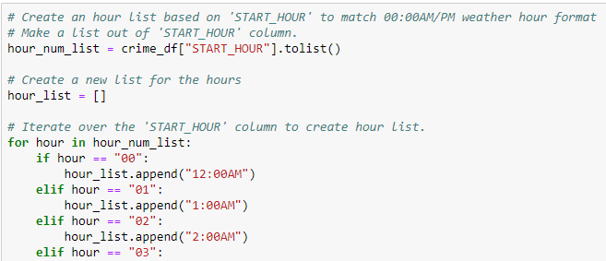
Merge on Date and Hour
Notes:
Jonathan

Slide 13
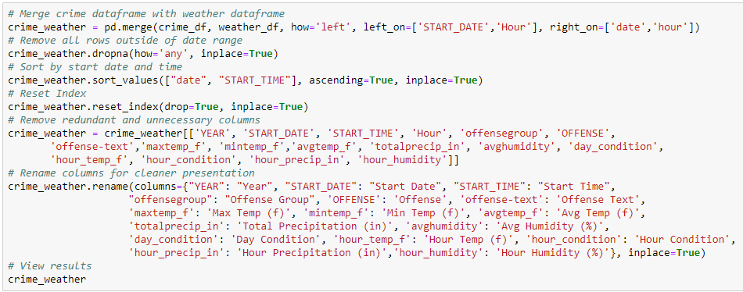
Merge Code
Notes:
Jonathan

Slide 14
The analysis process Conclusions, including numerical summary and visualizations

Slide 15
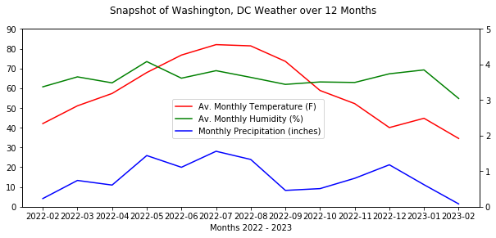
Look at Weather Data

Slide 16
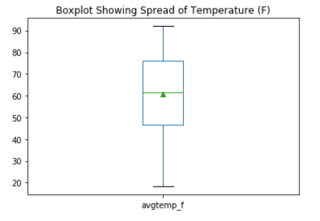
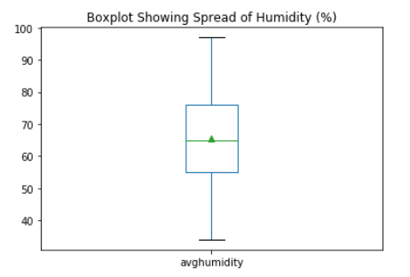
Look at Weather Data

Slide 17
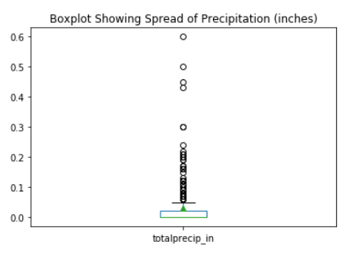
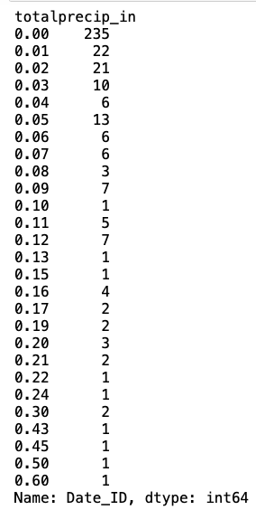
Look at Weather Data

Slide 18
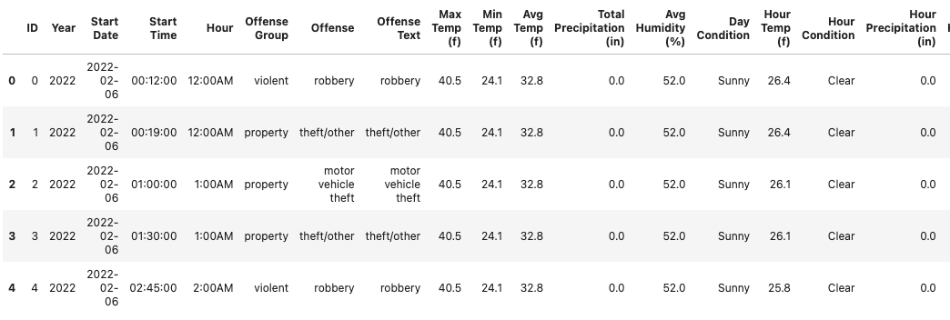
Look at Merged Data

Slide 19
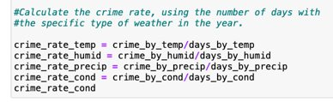
Look at Merged Data

Slide 20
Hypotheses
Null Hypothesis: In DC, there is no change in the reported thefts from vehicles and motor vehicle thefts on days based on temperature, humidity, or precipitation. / There is no correlation between crime rate and weather.
Alternative Hypotheses:
In DC, there is a significant change in the reported rate of thefts from vehicles and motor vehicle between days/times of high temperature vs moderate and low temperatures. / There is a correlation between crime rate and temperature.
In DC, there is a significant change in the reported rate of thefts from vehicles and motor vehicle between days/times of high humidity vs moderate and low humidity. / There is a correlation between crime rate and humidity.
In DC, there is a change in the reported rate of thefts from vehicles and motor vehicle thefts on days where there is no precipitation compared to days with precipitation. / There is a correlation between crime rate and precipitation.

Slide 21

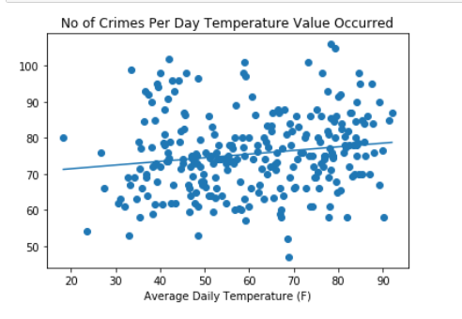
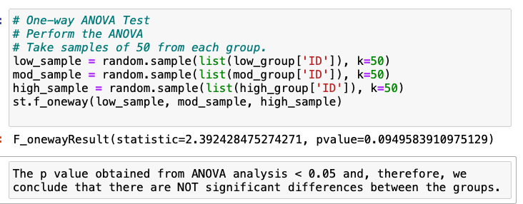
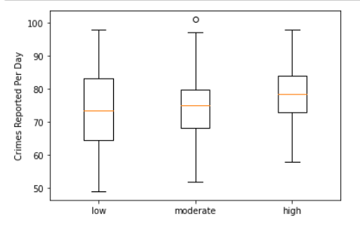
Look at correlation = Temperature

Slide 22
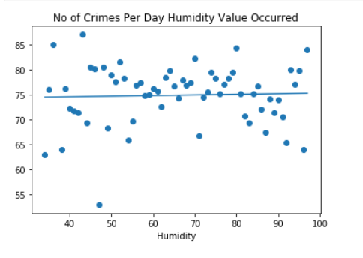
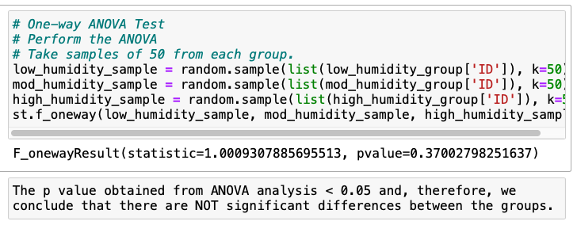
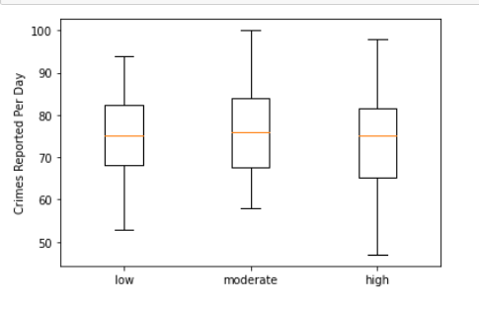
Look at correlation = Humidity

Slide 23
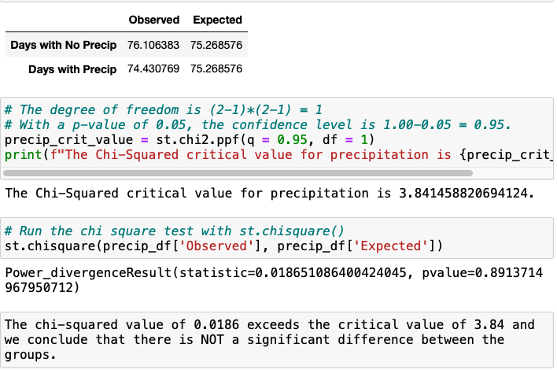
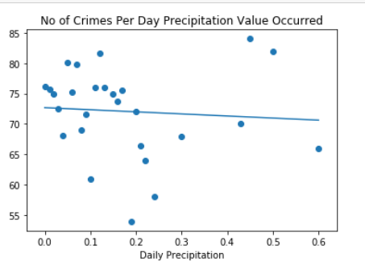
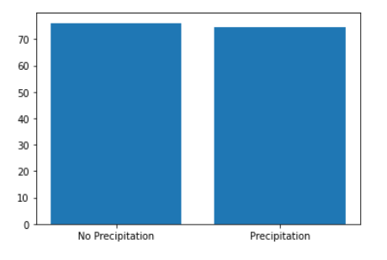
Look at correlation = Precipitation

Slide 24
The implications of the findings: what do they mean
Crime in DC
Weather in DC
Allocate Resources
Crime in DC is consistent over the course of the last year. The number of reported crimes do not vary based on any of the conditions that this project reviewed.
The weather in DC varies over the course of the year but the majority of the year falls within the moderate temperatures and humidity ranges.
Allocating resources so that your patrols can face all the different types of weather is an important step you can take to help with the theft from motor vehicles and motor vehicle thefts that are such a common occurrence in DC.

